Slide 1

Exploring Advanced Python Libraries:
Pandas
This presentation will explore the capabilities of the Pandas library for data manipulation, its significance
in data analysis, and applications across various industries.
Rushi A. Patel
EN. NO : 23020304001ì6

Slide 2
Introduction to the Pandas Library
0 Overview of Pandas
Pandas is an open-source data analysis and manipulation library for Python, established in 2008 by Wes McKin ney.
0 DotoFrome Structure
A DataFrame is a two-dimensional, size-mutable, and potentially heterogeneous tabular data structure with labeled axes.
0 Series Data Type
A Series is a one-dimensional labeled array capable of holding any data type, simplifying data handling.
o Data Alignment Features
Pandas provides automatic alignment of data Jor easy merging and joini ng of datasets, enhancing usability.
o Flexible Reshaping Tools
Pandas offers tools for reshaping and pivoting datasets, making data manipulation straightforward.
0 Handling Various Formats
The fibrary can manage different data formats, including CSV, Excel, and SQL databases, for versatile data analysis.
ea
g
proseutotionsœ

Slide 3
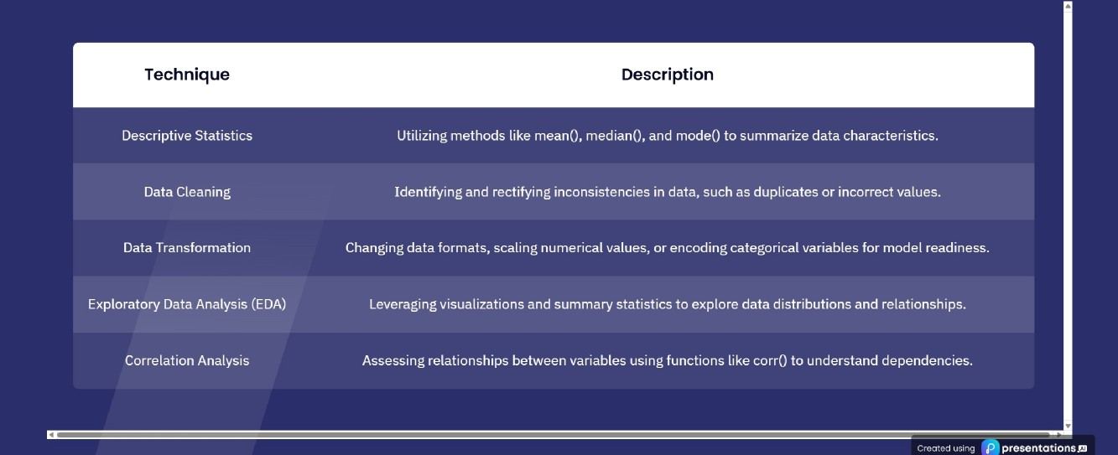
Essential Data Analysis Techniques
Key methods for extracting data insights

Slide 4




Exploring Statistical Methods in
Pandas
Key statistical tech niques offered by Pandas
e
Pnndo soffers diverse statistical methods for
S
Descriptive Stati stics
Descriptive statistics summarize dataset characteristics.
Hypothesis Testing
Hypothesis testing allows for statistical validation.
Regression Analysis
Time Series Analysis
Regression analysis aids in predictive modeling.
Data Vis ualization
Time series analysis helps in understanding trends.
60
Statistical Method
ea
g
proseutotionsœ

Slide 5
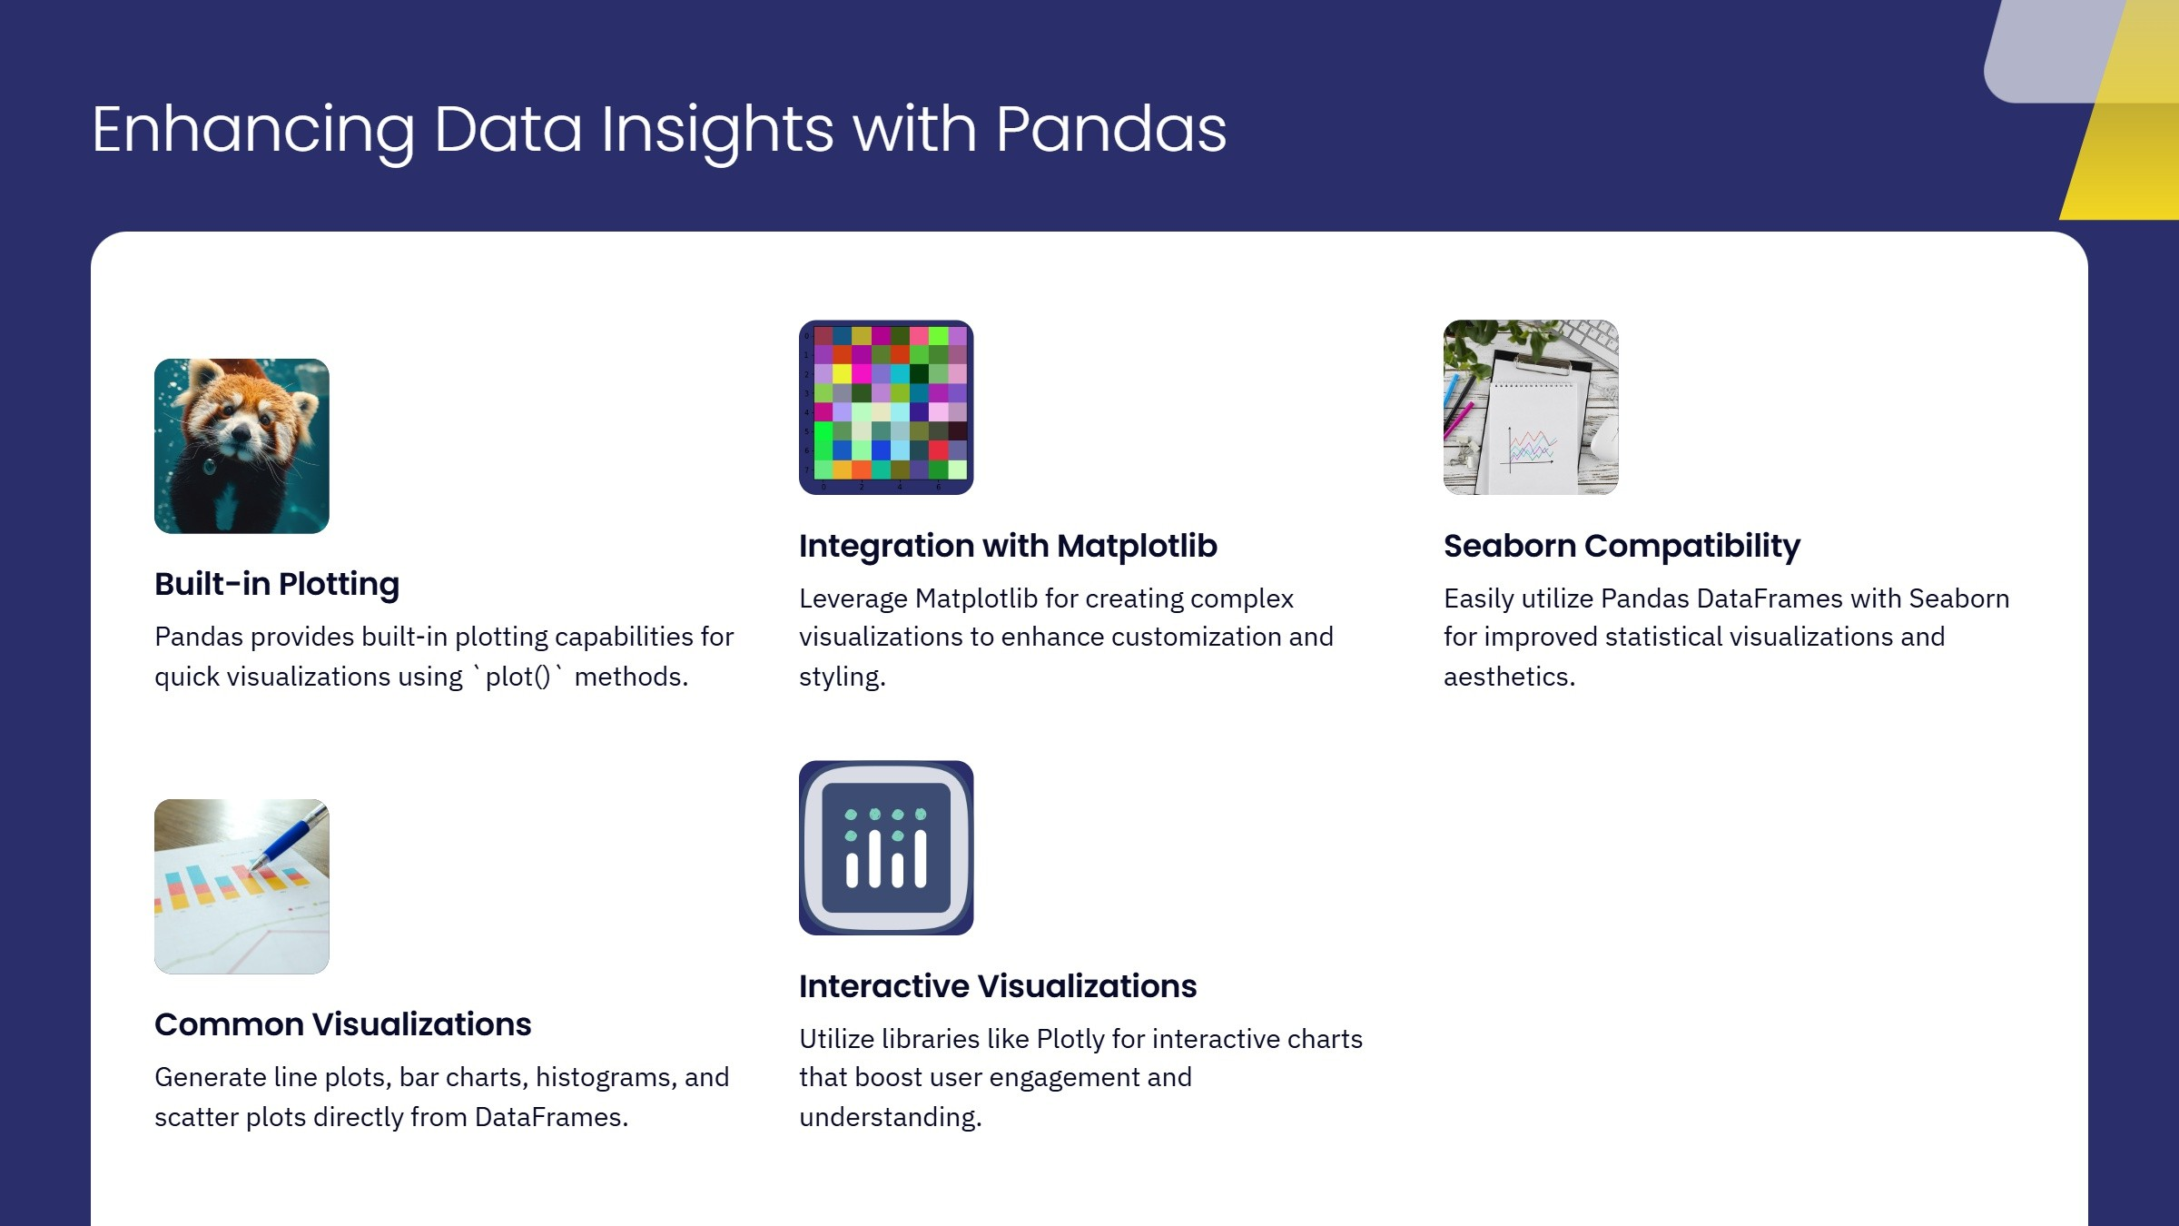


Slide 6
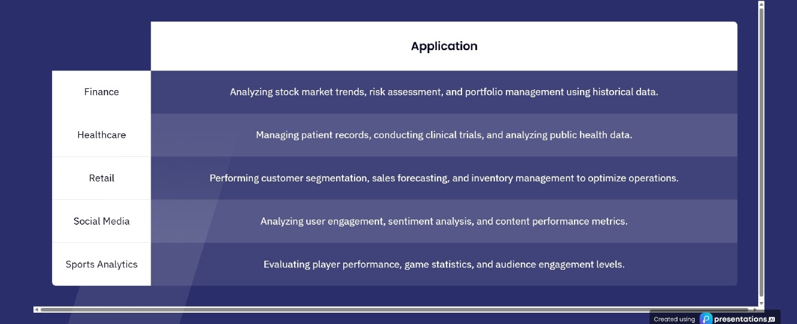
Real—World Applications of Pandas
Pandas' versatility across various sectors

Slide 7

Key Performance Considerations for Pandas
Here's where you can provide additional context and details about your AI- Enhanced concise head line.
ea
g
proseutotionsœ

Slide 8
Pandas vs Other Data Analysis Libraries
Strengths
Weaknesses
Pandas excels in data manipulation with labeled axes,
While powerful, Pandas can struggle with very large
making it suitable for complex data operations and
datasets in terms of performance compared to libraries
analysis.
like Dask and Vaex.
Threats
Opportunities
Emerging libraries like Vaex and Dask offer specialized
The integration of Pandas with other libraries like I 1odin
functionalities that may appeal to users needing high
opens up possibilities for enhanced performance and
performance on large datasets, posing competition to
scalability in data analysis.
Pandas.
ea
g
proseutotionsœ

Slide 9
Emerging Trends in Data Analysis with Pandas
2024 | 2024 | 2025
Enhanced Performance | Integration with ML | User Experience Improvements
Future versions of Pandas will enhance | Pandas is expected to integrate closely with | Continued API enhancements will improve
performance for larger datasets and multi- | TensorFlow and PyTorch for data preparation. | usability and consistency for users.
threading.
ea
g
proseutotionsœ

Slide 10


Slide 11


